Slide 1
NUMERICAL DIFFERENTIATION AND INTEGRATION Prof. Samuel Okolie, Prof. Yinka Adekunle & Dr. Seun Ebiesuwa

Slide 9
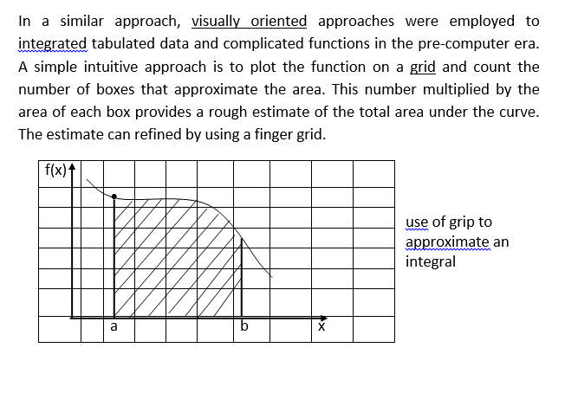

Slide 10
